Slide 1
Open Data Visualization with Carto

Slide 2
Data from Malaga town hall website (horse carriage stops, water fountains and noise map)

Slide 3
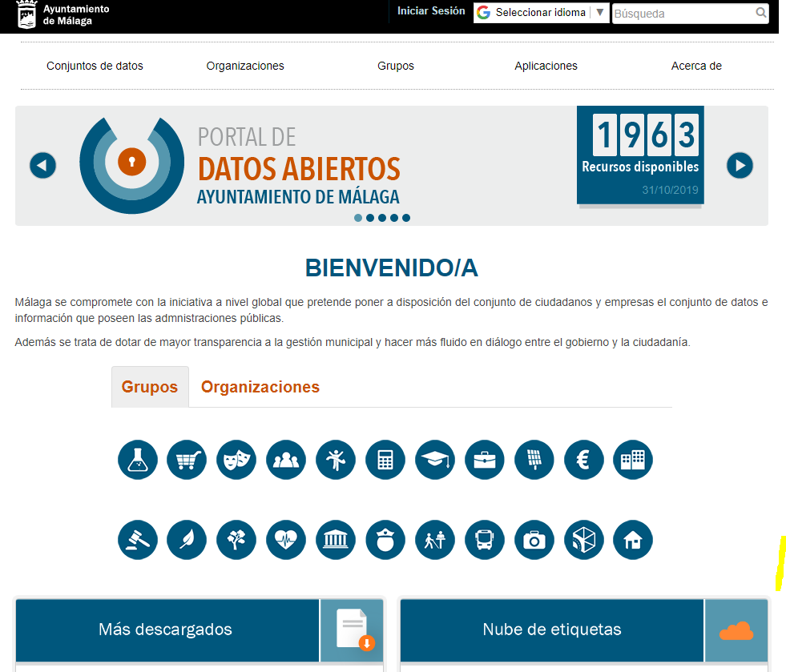
Step 1: https://datosabiertos.malaga.eu/

Slide 4
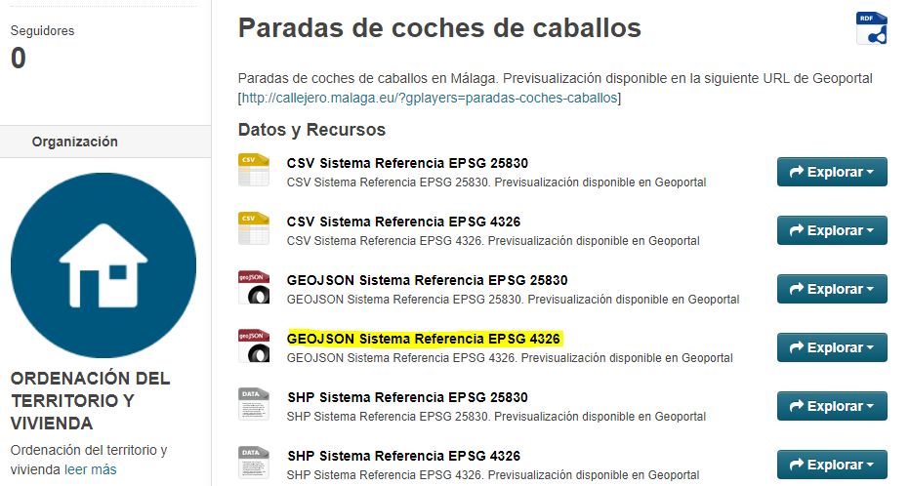
Step 2: Select data sources

Slide 5
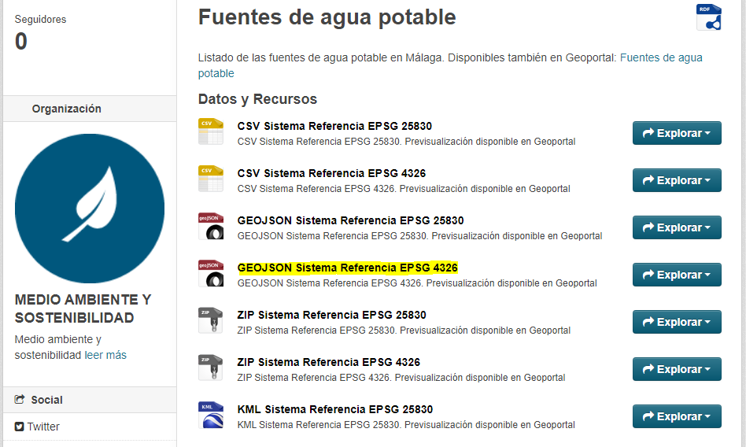

Slide 6
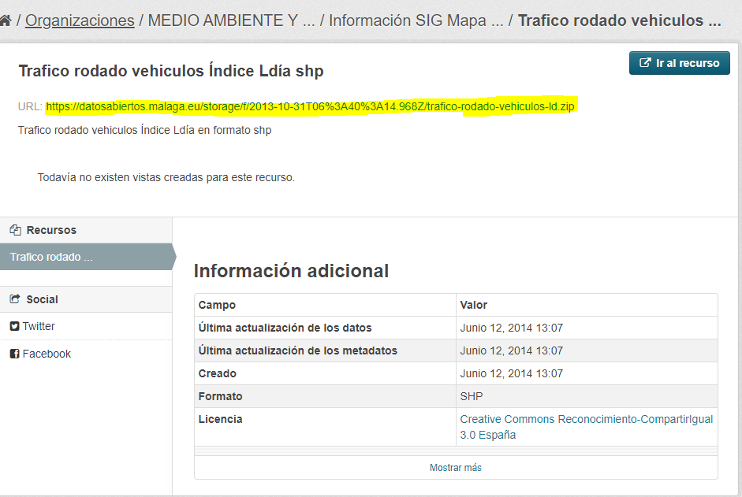

Slide 7

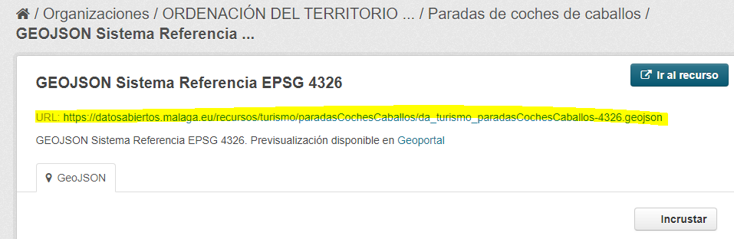
Step 3: Import the main data source in www.carto.com

Slide 8
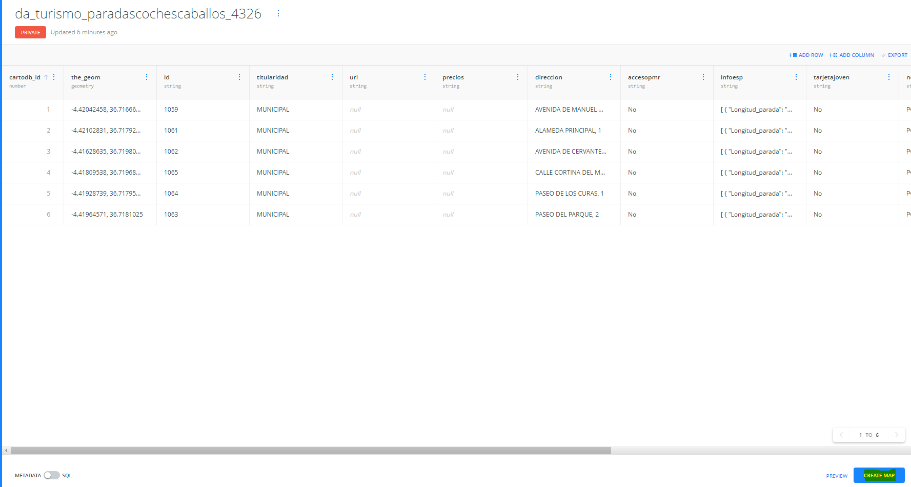
Step 4: Create the Map

Slide 9
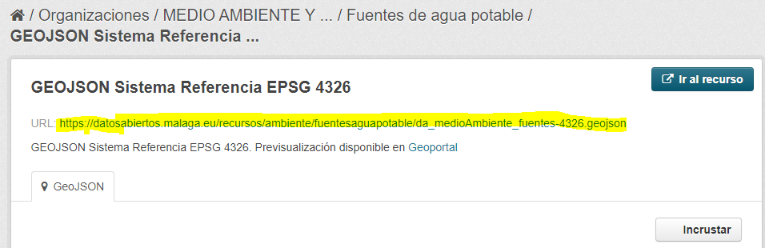
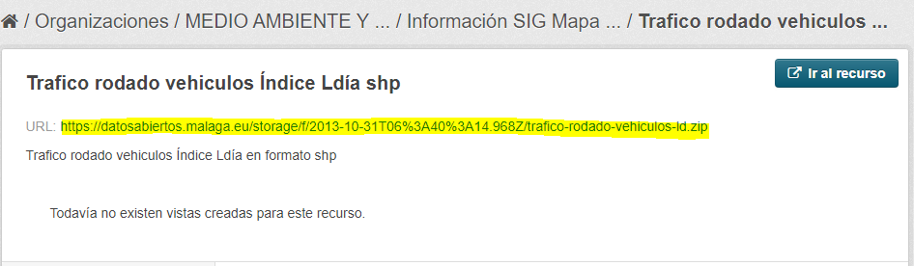
Step 5: Include new layers

Slide 10
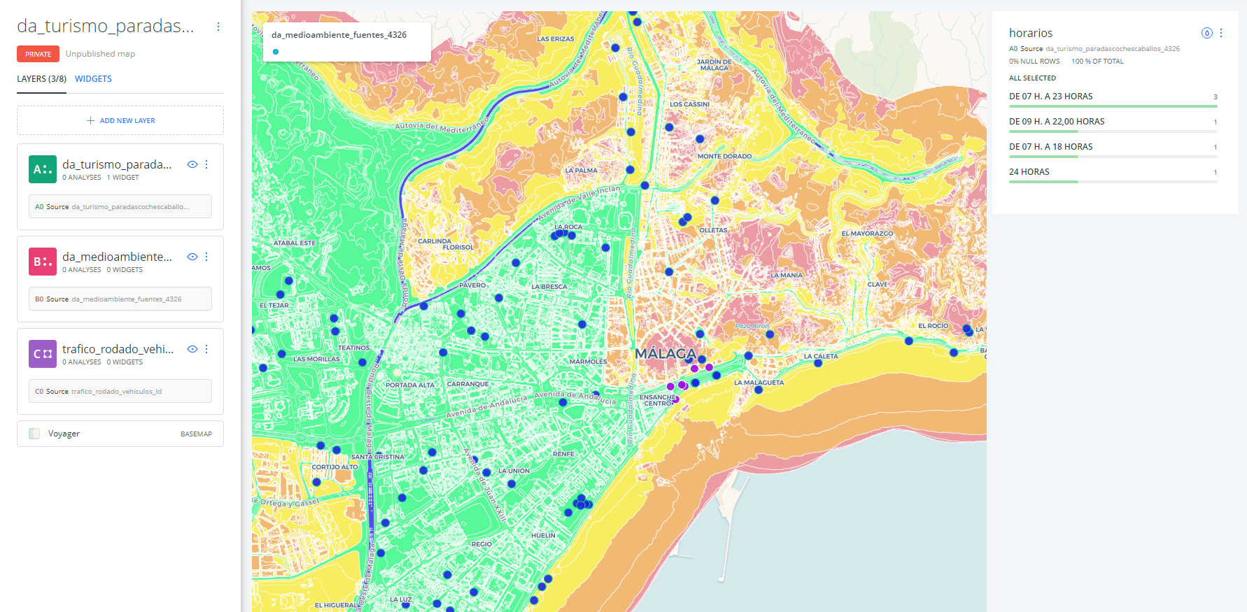
Step 6: Display each layer
I added a widget to know when the carriages work and comparing with traffic layer you can see how fast/slow, comfortable/uncomfortable will be your trip

